Slide 1
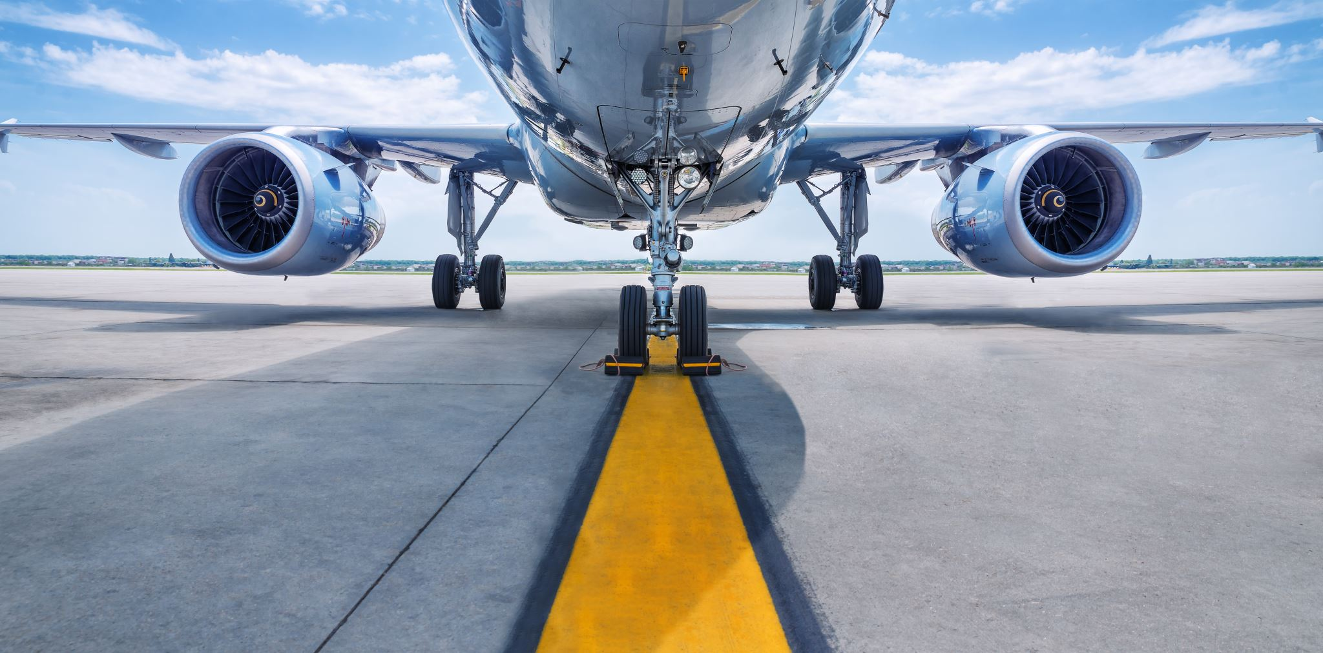

Airline Safety
US Airways Keeps You Safe!
Notes:
Welcome! My name is Harlan Wittlieff, and I am excited to tell you about how you and your family can fly safely with US Airways!

Slide 2
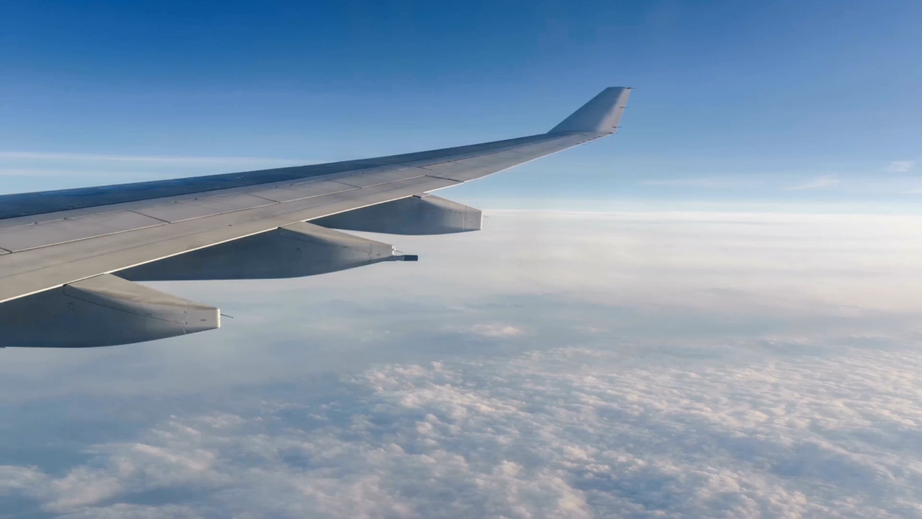

US Airways
Ranks in
Top 10 Safest Airlines
*Based on fatalities per billion seat miles
Notes:
Did you know that US Airways ranks in the Top 10 Safest Airlines based on fatalities per billion seat miles?
Our passenger’s safety is our highest priority!
Our planes feature state of the art safety technology and are inspected before each and every flight by trained professionals.
Our commitment to safety really shows!

Slide 3
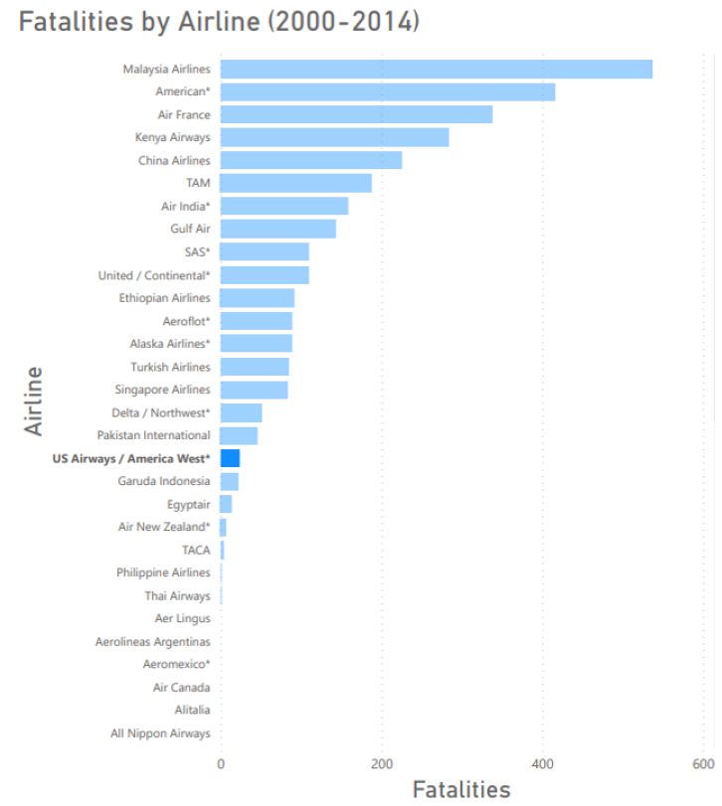
US Airways
saw 58% fewer fatalities than the average Airline
US Airways pilots take
over 160 hours
of safety training each year!
That’s over twice the training time as our competitors!
Notes:
US Airways saw 58% fewer fatalities than the average Airline.
Just look at those numbers!
Our pilots take over 160 hours of safety training each year. That’s over twice the amount of training time as our competitors.

Slide 4
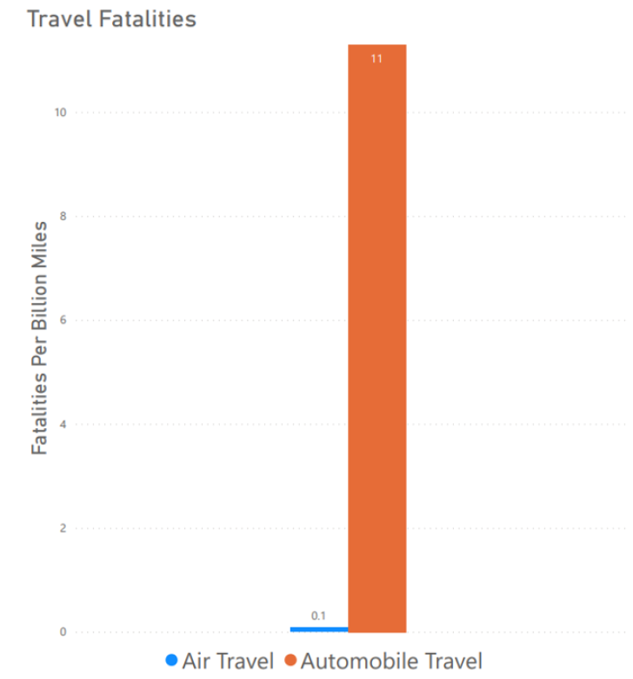
Fly with Confidence!
Air travel is safer than traveling by automobile
Notes:
When you fly US Airways, you can fly with confidence.
Air travel is actually safer than traveling by automobile with 99% fewer fatalities.

Slide 5
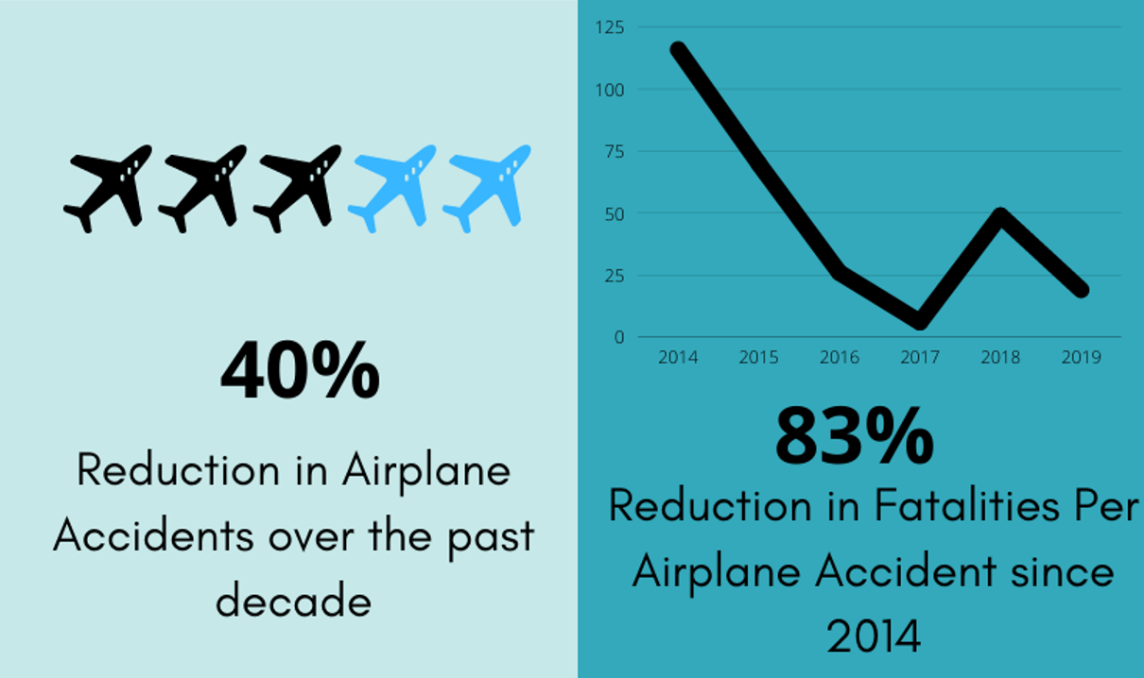
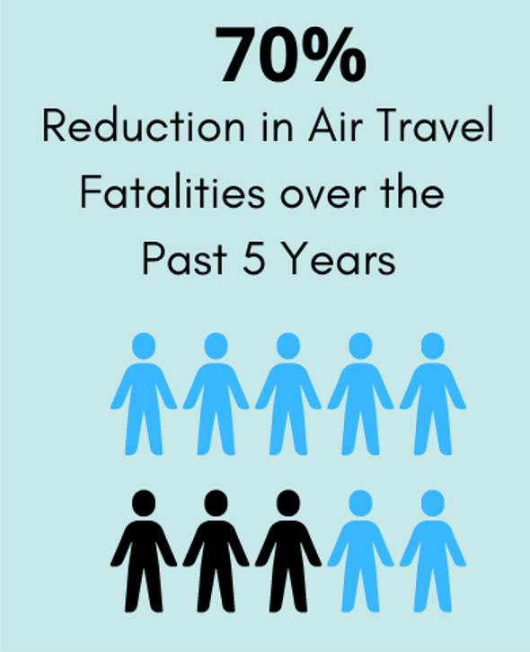
Air travel is becoming even safer!
Notes:
Air travel is becoming even safer every day!
Over the past decade there has been a 40% reduction in airplane accidents.
Since 2014, airlines have achieved an 83% reduction in fatalities per airplane accident.
Finally, over the past five years we’ve seen a 70% reduction in air travel fatalities!

Slide 6
Thank you for watching!
Learn More at usairways.com
Notes:
We at US Airways want to thank you for taking the time to watch this informative video.
You can learn more at www.usairways.com
See you soon!

